Slide 1


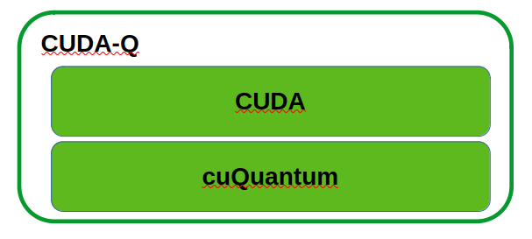
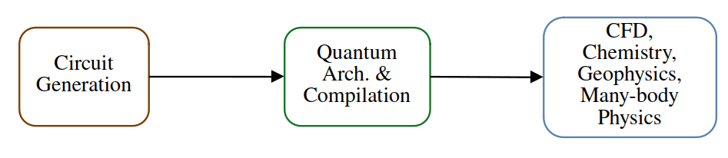
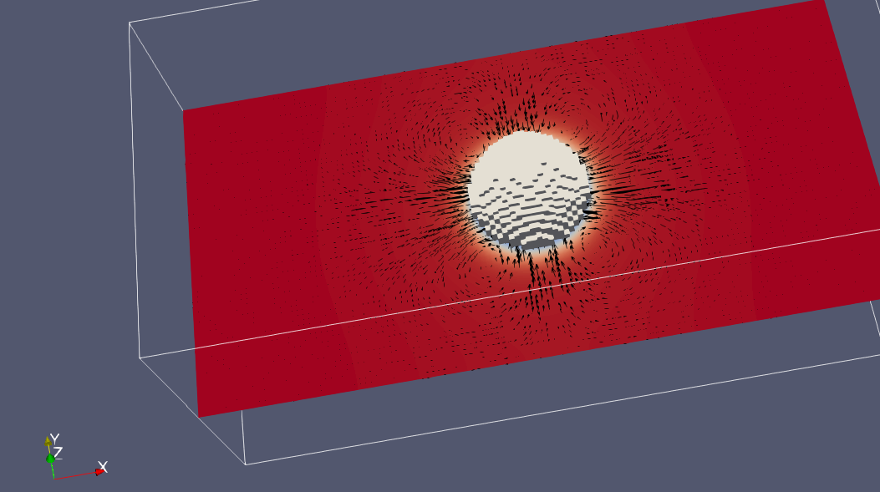
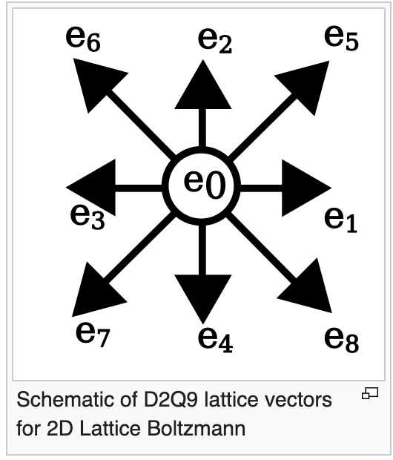
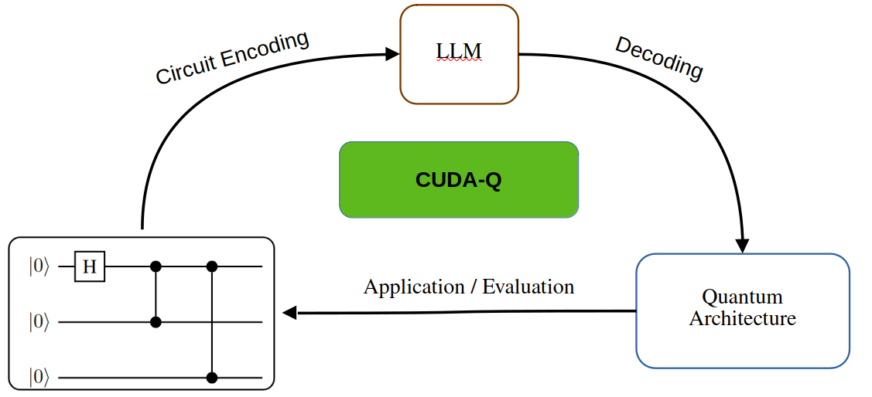
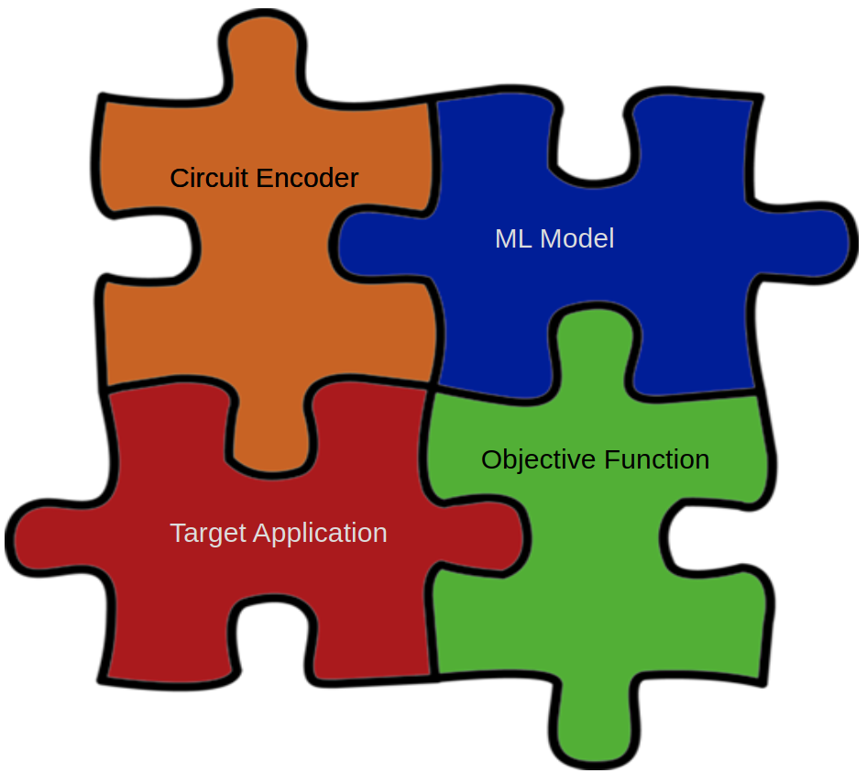
Diffusing Quantum Circuits for Computational Fluid Dynamics
Will Buziak
Iris Bahar
Pooja Rao
Department of Computer Science Department of Computer Science NVIDIA
Abstract
CFD
CUDA-Q
Large-Language Models
Classical CFD modeling methods struggle to scale for real-world applications.
Quantum Architecture Search (QAS) and other machine-learning techniques can generate viable quantum circuits.
This work proposes the use of LLMs for quantum circuit generation in hopes to better utilize complex quantum modeling techniques.
Classical modeling methods are expensive due to an inability to scale for:
  Large / dense domain sizes
  Long-term model stability
We are interested in making quantum algorithms for modeling complex systems viable for execution on real quantum hardware.
The target application dictates all other aspects of this framework.
NVIDIAs quantum SDK, CUDA-Q enables:
  Parallelization
  Hamiltonian Simulation
  Multi-GPU acceleration
CUDA-Q wraps NVIDIAs backend development kits, targeting high performance applications:
  cuQuantum: Library that accelerates quantum simulations on a circuit & device-level.
  CUDA: GPU development SDK
Ideal for hybrid quantum-classical procesing and HPC applications.
By placing CUDA-Q at the center of this framework indicates the full utilization of hardware acceleration at every step.
Quantum circuit generation with diffusion models resembles image generation.
Motivation
Insights
Quantum-inspired CFD Algorithms have shown to be atleast as efficient as classical Navier-Stokes simulations.
Quantum Architecture methods such as gate cutting can further improve the fidelity of a quantum circuit and reduce depth.
An ML workflow with CUDA-Q at the center enables us to completely utilize the entire hardware stack for hybrid quantum-classical processing.
Quantum circuit generation mitigates the need for high-level algorithm expertise.
The Evaluation metric can prune circuits with low fidelity, or inability to solve the target application.
Each major component of this paradigm is intended to be interchangeable, opening the door for a larger swath of applications.
Quantum computing provides speedups over classical solutions when algorithms can map to an algorithm that takes advantage of entanglement similarities.
Challenges
Quantum Hardware is noisy & reliable algorithm design is non-trivial.
Classical models experience exponential blowup when scaling to real-world systems.
Each component is intended to be an interchangeable piece to target a large swath of applications

